Slide 1

Applied Science and Engineering Project (ASEP) Course Code: CS1011 Mid Semester Review Activity Presentation
AI- Based Smart Health And Location Monitoring System
BRACT’S, Vishwakarma Institute of Technology, Pune-37
(An Autonomous Institute affiliated to Savitribai Phule Pune University) (NBA and NAAC accredited, ISO 9001:2015 certified)

Slide 2

Applied Science and Engineering Project 1 (ASEP1) Project_PPT for Mid Semester Assessment – November 2025
Div:-CS-I ASEP Group No:-11 Day:-Friday Date:-12/12/2025
Project Title:- AI- Based Smart Health And Location Monitoring System
Presented by
Rajas Ghongade (1251070897)(GL)
Rahul Gore (1251070789) (AGL)
Chaitanya Rajmane (1251070560)
Kunal Rahangdale (1251070556)
Project Guide
Dr. Sachin Jadhav
Department of Engineering, Sciences and Humanities
Vishwakarma Institute of Technology, Pune
Roll Nos: 50,51,52,53, Department of Engineering, Sciences and Humanities, VIT, Pune

Slide 3
Introduction of ASEP Topic
Project Title: AI-Based Smart Soldier Health and Location Monitoring System
Domain Areas: Defence, Healthcare, Security Systems, Assistive Aid
Project Overview / Problem Definition: In modern defence operations, the safety and health of soldiers are of utmost importance. However, monitoring a soldier’s physical condition and location in real-time during missions remains a significant challenge. Traditional communication systems fail to provide health analytics or situational awareness, often delaying critical medical assistance.
To address this, the proposed project introduces an AI-based health and location monitoring
system that continuously tracks soldiers’ vital parameters and GPS position using IoT-enabled
wearable sensors. The data is processed using Artificial Intelligence algorithms to predict
fatigue, dehydration, or potential health risks. In emergencies, automatic alerts with location
coordinates are sent to the command center, ensuring rapid decision-making and rescue
response.
Roll Nos: 50,51,52,53, Department of Engineering, Sciences and Humanities, VIT, Pune

Slide 4
Objectives:
1. To design an IoT-enabled wearable system for real-time monitoring of soldiers’ health and location.
2. To implement AI algorithms for early detection of abnormal physiological patterns.
3. To provide automated emergency alerts with GPS coordinates in critical situations.
4. To ensure data reliability, portability, and energy efficiency of the overall system
Roll Nos: 50,51,52,53, Department of Engineering, Sciences and Humanities, VIT, Pune

Slide 5
Materials / Components
1. ESP32 DevKit – A microcontroller board based on ATmega328P, used to control sensors and modules in electronic projects. 2. DHT11 Temperature & Humidity Sensor – A precision analog temperature & humidity sensor that measures temperature in °C, used for environmental monitoring. 3. MAX30100 Pulse Oximeter Sensor – An optical heart rate sensor that detects pulse signals, used in health and fitness monitoring systems. 4. 16x2 LCD I2C – A character display with I2C interface that shows data using only two wires, used for displaying sensor readings. 5. SIM800L – A GSM/GPRS module used for sending SMS, calls, and internet data, commonly used in IoT communication projects. 6. GPS Module (NEO-6M) – A satellite navigation module that provides latitude, longitude, and time data, used for location tracking. 7. 12V Adapter – A power supply adapter that provides a stable 12V DC output, used to power modules and circuits.
Roll Nos: 50,51,52,53, Department of Engineering, Sciences and Humanities, VIT, Pune

Slide 6
8. Buck Converter (LM2596) – A DC-to-DC step-down voltage converter used to regulate higher voltage into lower usable levels.
Roll Nos: 50,51,52,53, Department of Engineering, Sciences and Humanities, VIT, Pune

Slide 7
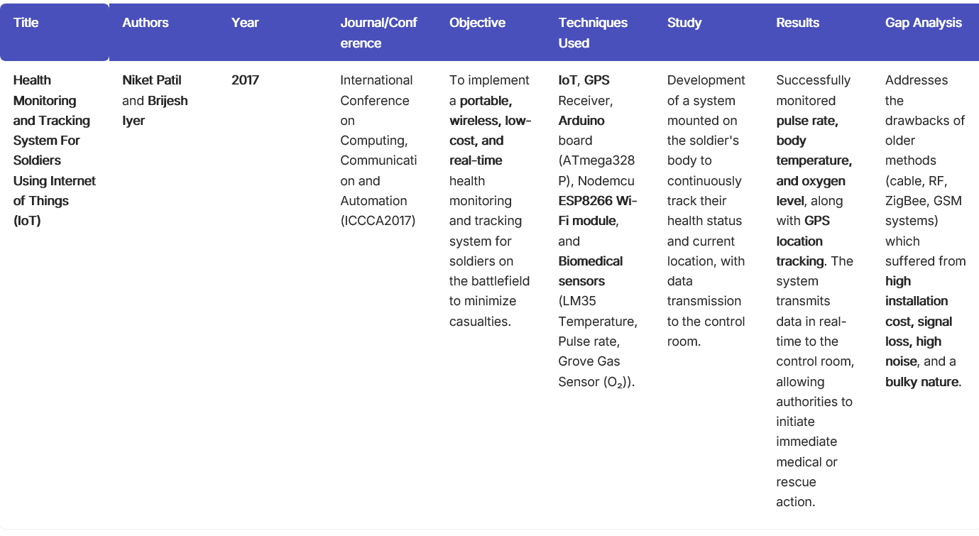
Literature Review
Roll Nos: 50,51,52,53, Department of Engineering, Sciences and Humanities, VIT, Pune

Slide 8
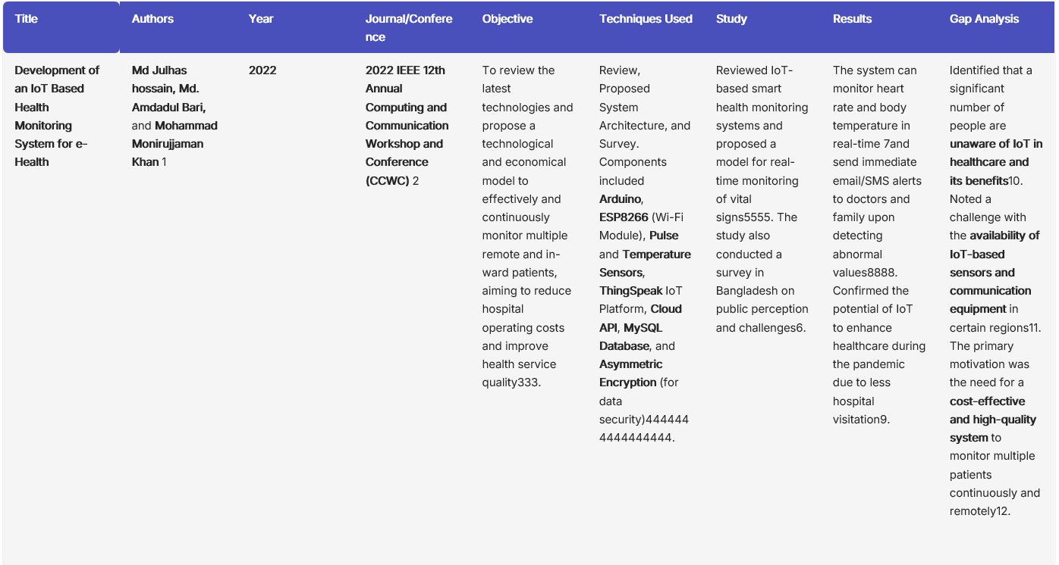
Roll Nos: 50,51,52,53, Department of Engineering, Sciences and Humanities, VIT, Pune

Slide 9
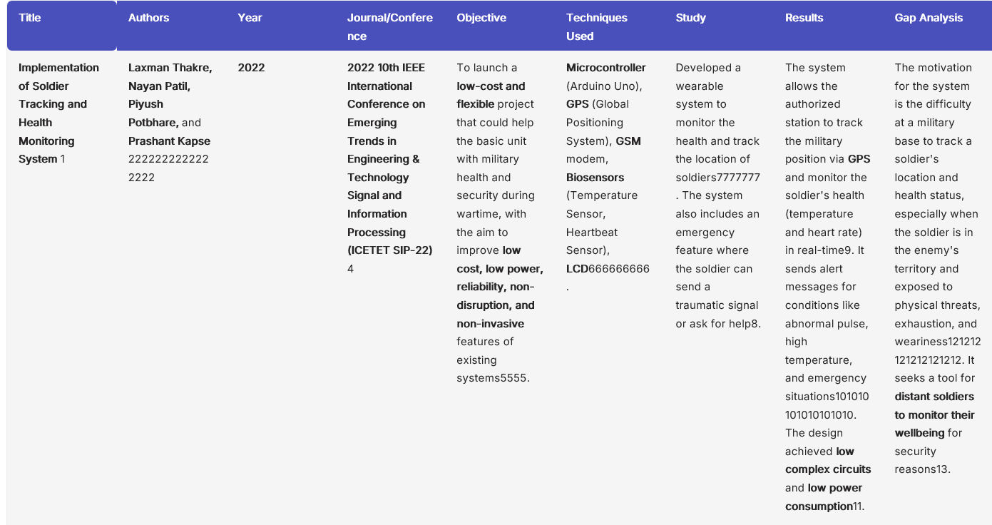
Roll Nos: 50,51,52,53, Department of Engineering, Sciences and Humanities, VIT, Pune

Slide 10
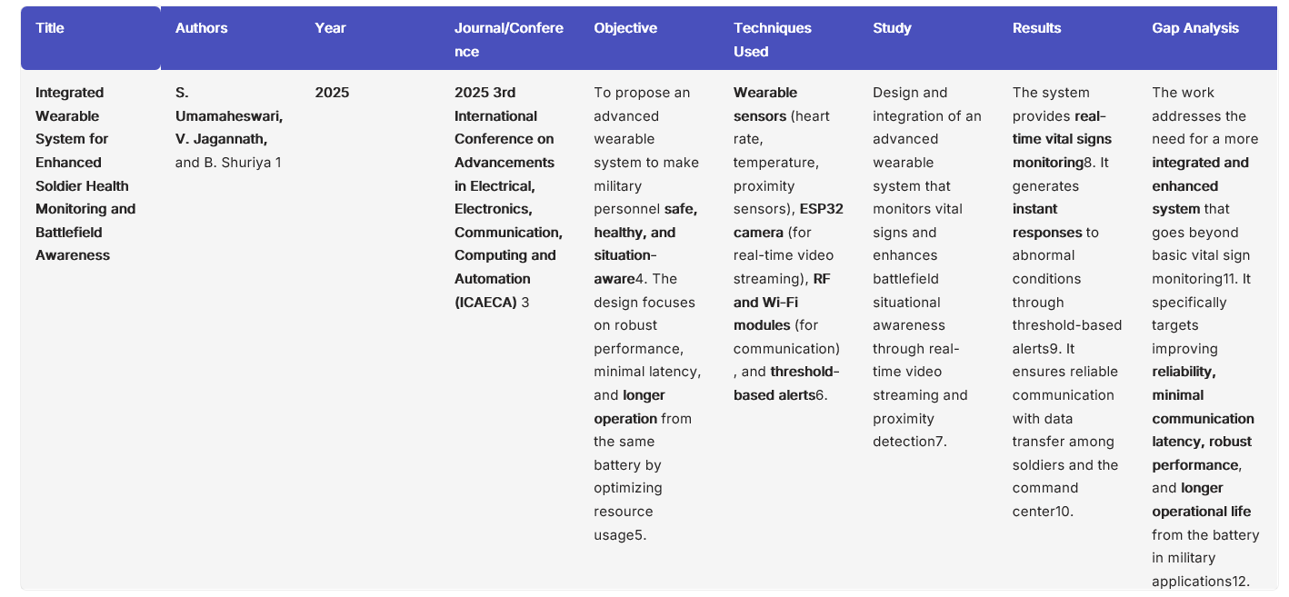
Roll Nos: 50,51,52,53, Department of Engineering, Sciences and Humanities, VIT, Pune

Slide 11
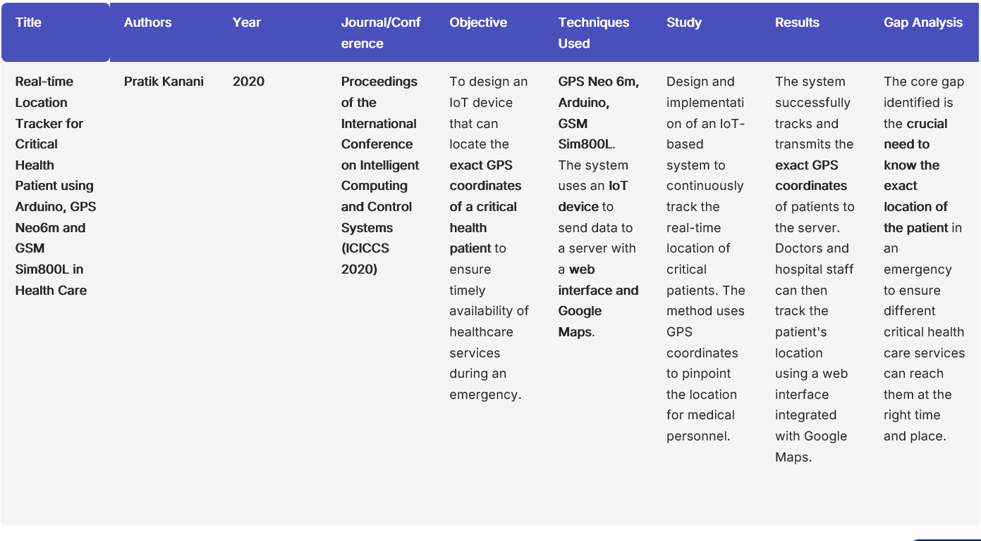
Roll Nos: 50,51,52,53, Department of Engineering, Sciences and Humanities, VIT, Pune

Slide 12
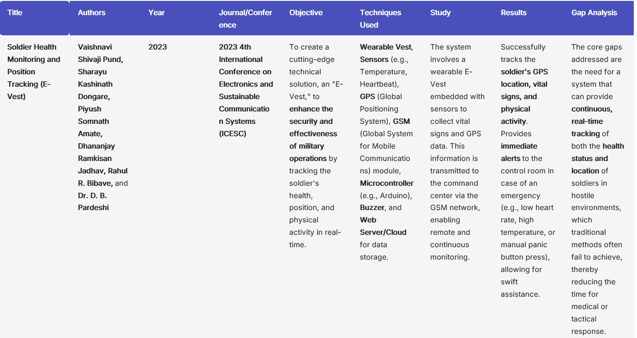
Roll Nos: 50,51,52,53, Department of Engineering, Sciences and Humanities, VIT, Pune

Slide 13
Implemented Methodology
1. PROJECT PLANNING & DESIGN
System Requirements Analysis:
Identified need for multi-sensor health monitoring system
Determined required parameters: temperature, humidity, location, vital signs, communication
Selected appropriate sensors and modules based on functionality and compatibility
Hardware Selection:
Microcontroller: Initially Arduino Uno R3, later migrated to ESP32 due to memory and power limitations
Sensors: DHT11 (temperature/humidity), GPS (location), MAX30100 (heart rate/SpO2)
Display: 16x2 LCD with I2C for reduced pin usage
Communication: SIM800L GSM module for alerts and emergency calls
Power: Buck converter and separate supplies for high-current modules
Circuit Design:
Created pin mapping for all modules on ESP32
Designed multi-rail power distribution (5V, 3.3V, 4V)
Planned communication protocols (I2C, UART, Digital)
Established common ground architecture
Roll Nos: 50,51,52,53, Department of Engineering, Sciences and Humanities, VIT, Pune

Slide 14
2. HARDWARE IMPLEMENTATION
Phase 1 - Initial Prototype (Arduino Uno):
Connected sensors and modules to Arduino Uno
Tested individual modules for functionality
Result: Uno burned out due to SIM800L power draw (2A > 500mA limit)
Phase 2 - Power System Redesign:
Implemented separate 4V supply for SIM800L (2A capable)
Added buck converter for stable 5V to ESP32
Created breadboard power rails for organized distribution
Result: Uno still faced memory overflow (2KB RAM insufficient)
Phase 3 - Migration to ESP32:
Replaced Arduino Uno with ESP32 DevKit
Remapped all pin connections to ESP32 GPIO pins
Configured multiple UART ports (Serial1 for GPS, Serial2 for SIM800L)
Result: Stable system with adequate memory (520KB RAM)
Roll Nos: 50,51,52,53, Department of Engineering, Sciences and Humanities, VIT, Pune

Slide 15
Breadboard Assembly:
Mounted ESP32 on breadboard center
Organized power rails: 5V (top), 3.3V (optional), 4V (separate), GND (bottom)
Connected all module VCC and GND to appropriate rails
Routed signal wires (SDA, SCL, TX, RX, DATA) to ESP32 GPIO pins
Ensured common ground for all components
Component Connections:
LCD: I2C on GPIO 21, 22 (shared bus)
DHT11: Digital on GPIO 4
GPS: UART Serial1 on GPIO 25, 26
SIM800L: UART Serial2 on GPIO 27, 14
MAX30100: I2C on GPIO 21, 22 (shared with LCD)
Roll Nos: 50,51,52,53, Department of Engineering, Sciences and Humanities, VIT, Pune

Slide 16
3. SOFTWARE DEVELOPMENT
Development Environment Setup:
Installed Arduino IDE
Added ESP32 board support package
Installed required libraries: Wire, LiquidCrystal_I2C, DHT, TinyGPSPlus, MAX30100_PulseOximeter
Code Architecture:
Modular Function Design:
setup() - Initialize all modules, test connections, display startup status
loop() - Main execution cycle with non-blocking timers
updateDHT11() - Read temperature and humidity every 2 seconds
updateGPS() - Parse NMEA sentences continuously
checkSIM800L() - Monitor incoming GSM data
displayTemperatureHumidity() - Show environmental data on LCD
displayGPS() - Show location coordinates
displaySystemStatus() - Show all module health indicators
Roll Nos: 50,51,52,53, Department of Engineering, Sciences and Humanities, VIT, Pune

Slide 17
Tools Used
Arduino IDE
Serial Monitor and Serial Plotter Used to view real-time health sensor data
Built-in Library Manager Provides easy access to essential libraries like TinyGPS++, DHT, PulseSensor, WiFi, and Bluetooth, which are crucial for reading sensor data,
Auto Error Detection and Debugging Support The IDE highlights syntax errors and helps troubleshoot code,
Code Uploading and Bootloader Support Allows seamless uploading of code to microcontrollers like Arduino Uno
Cross-Platform Compatibility and Board Manager Supports multiple boards including ESP32, Arduino Nano, NodeMCU, and AI-enabled boards, helping in testing different hardware platforms for real-time data monitoring.
Roll Nos: 50,51,52,53, Department of Engineering, Sciences and Humanities, VIT, Pune

Slide 18
Project Progress Review
The development of the project has advanced steadily due to effective teamwork and a clear division of responsibilities among the group members. Each member has demonstrated initiative and ownership of their assigned tasks, contributing to the overall progress of the system.
Rajas Ghongade (Group Leader) has taken charge of the hardware development and embedded systems programming. He successfully handled component interfacing, sensor integration, and power management solutions, ensuring that the electronic system operates reliably. His work on debugging electrical connectivity and coding the core device logic has been central to the functional development of the prototype. Rajas has consistently provided direction and demonstrated strong technical leadership throughout the hardware implementation phase.
Rahul Gore (Assistant Group Leader) has been responsible for documentation and research support. He collected and reviewed relevant research papers, standards, and literature that guided the theoretical direction of the project. His efforts ensured that the project maintains academic credibility and adequately references industry practices and prior research. Rahul’s documentation provides clarity and structured reporting of the project’s methodology and design rationale.
Roll Nos: 50,51,52,53, Department of Engineering, Sciences and Humanities, VIT, Pune

Slide 19
Chaitanya Rajmane has worked closely with Rajas on the coding aspect, assisting with troubleshooting logic, refining algorithms, and optimizing the integration of modules. Additionally, Chaitanya has contributed by exploring the future potential of IoT integration within the system, laying groundwork for features such as remote monitoring and cloud connectivity. His contributions bridge current implementation with forward-looking enhancements.
Kunal Rahangdale has supported Rahul in documentation activities while simultaneously investigating how AI technologies could be incorporated into the project. His work includes conceptual exploration of predictive analytics, pattern recognition, and intelligent automation possibilities that could enrich the system's functionality in later stages. Kunal’s involvement broadens the innovation scope of the project.
Overall Evaluation
The group has demonstrated strong interdisciplinary collaboration—spanning electronics, coding, documentation, and advanced technology research. All members are contributing effectively within their roles, and their combined efforts reflect solid project momentum, good communication, and technical competency. The current progress indicates a successful trajectory toward a fully-realized final implementation.
Roll Nos: 50,51,52,53, Department of Engineering, Sciences and Humanities, VIT, Pune

Slide 20
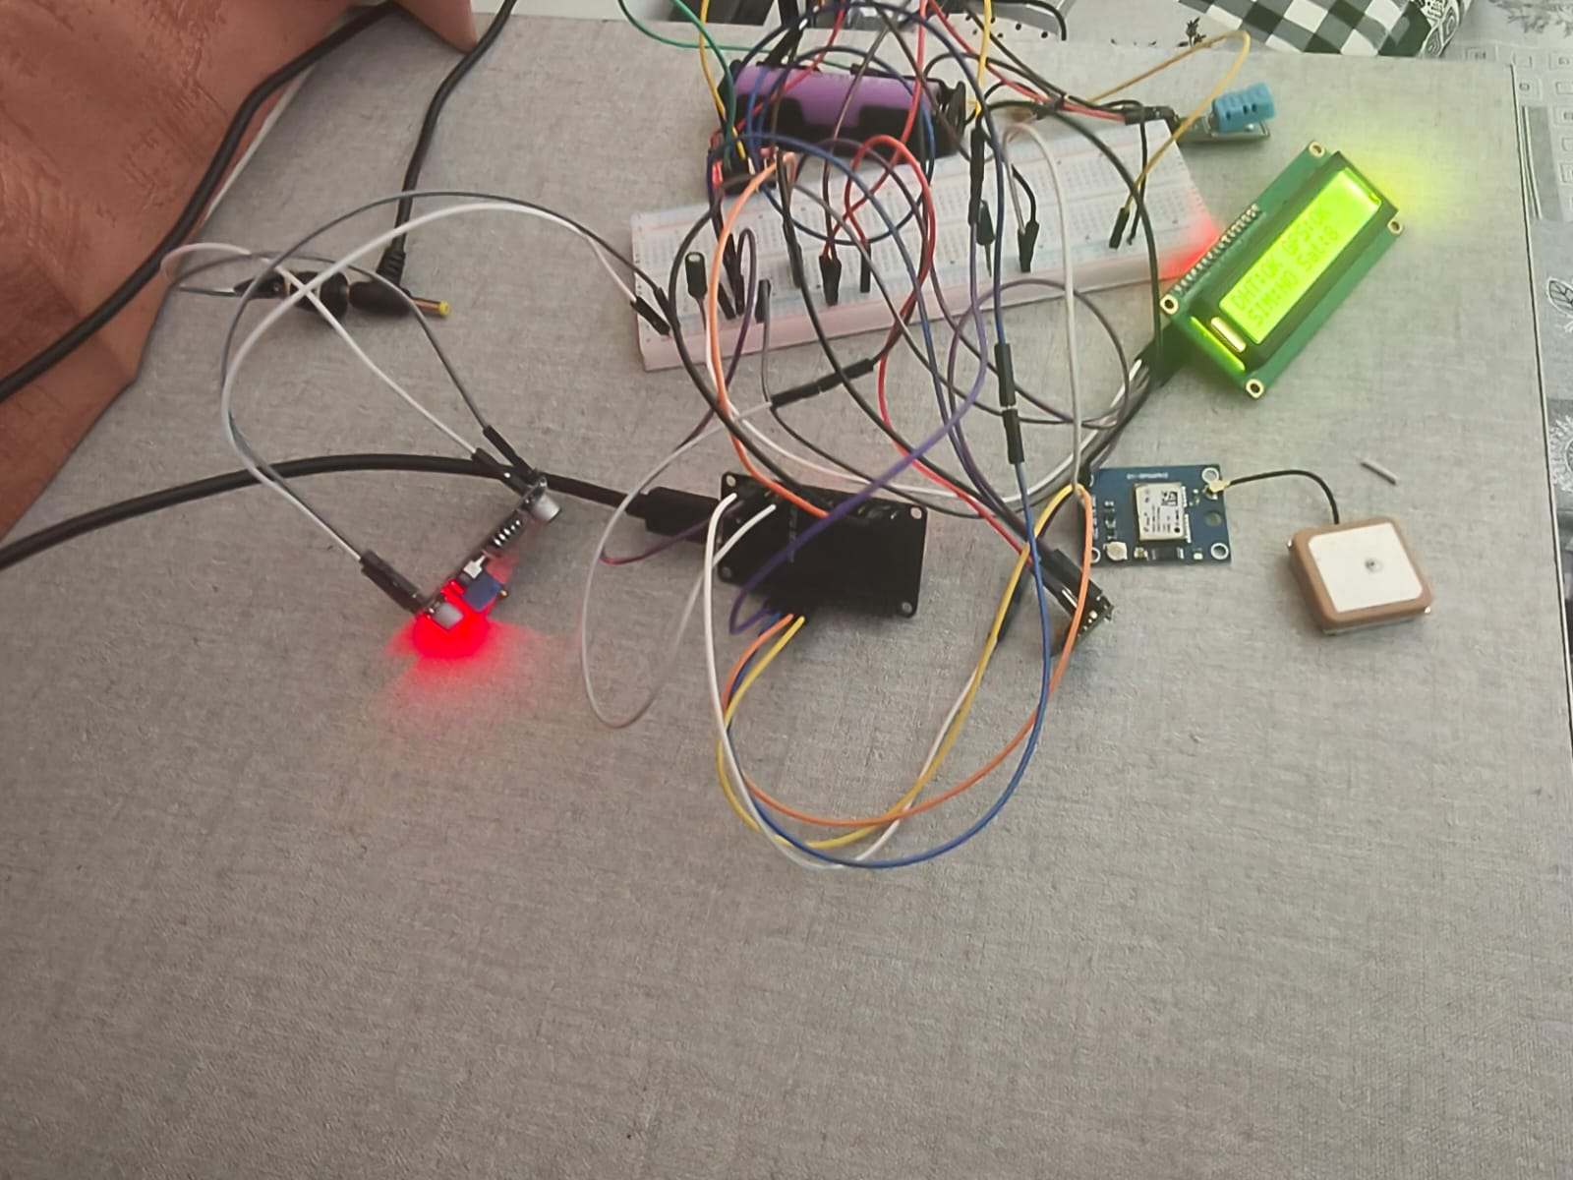
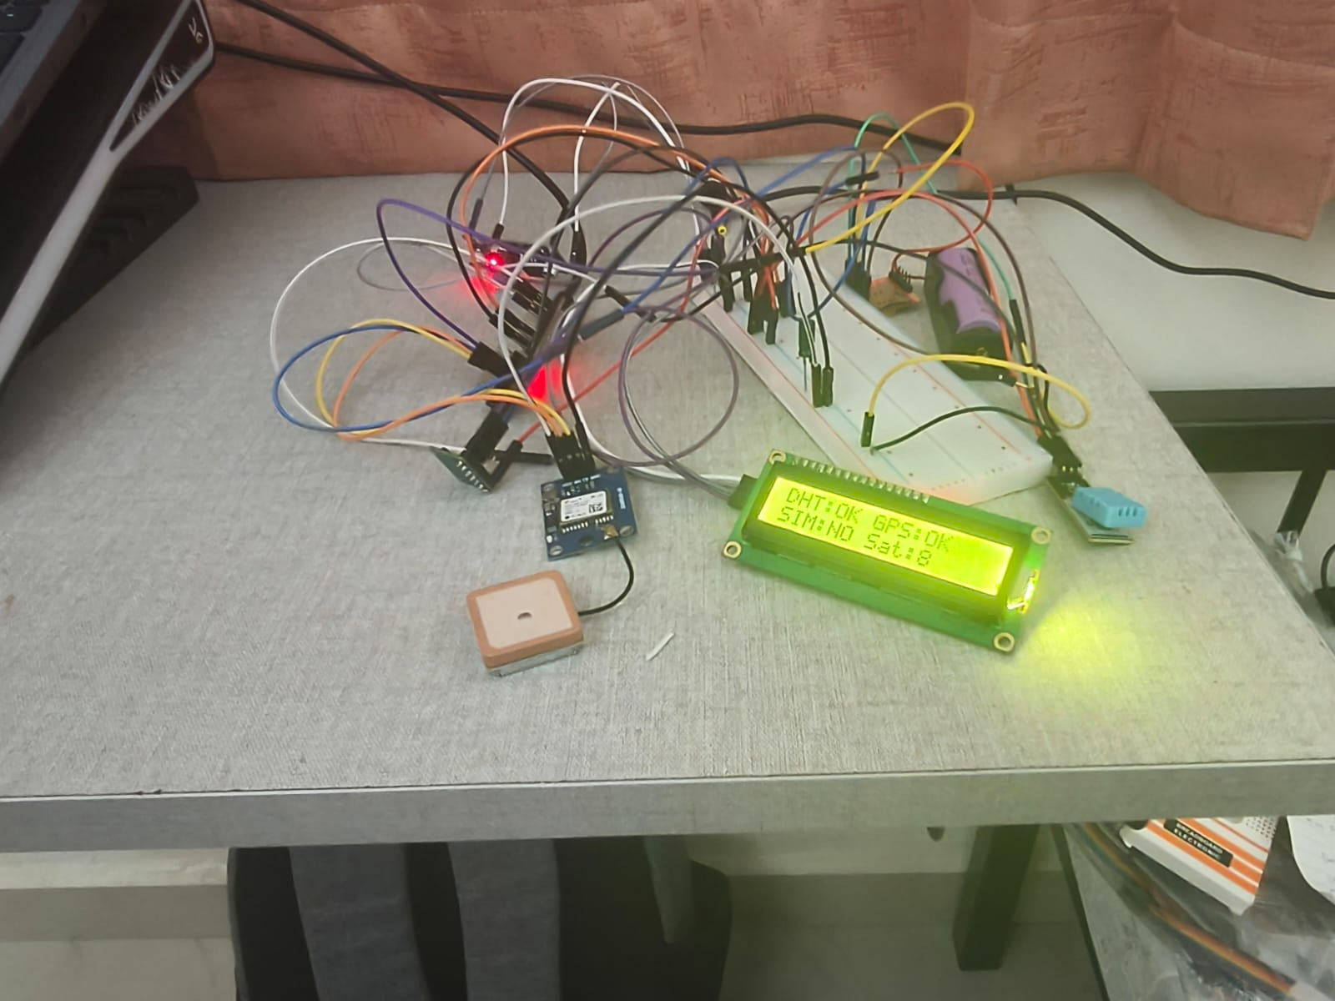
Roll Nos: 50,51,52,53, Department of Engineering, Sciences and Humanities, VIT, Pune

Slide 21
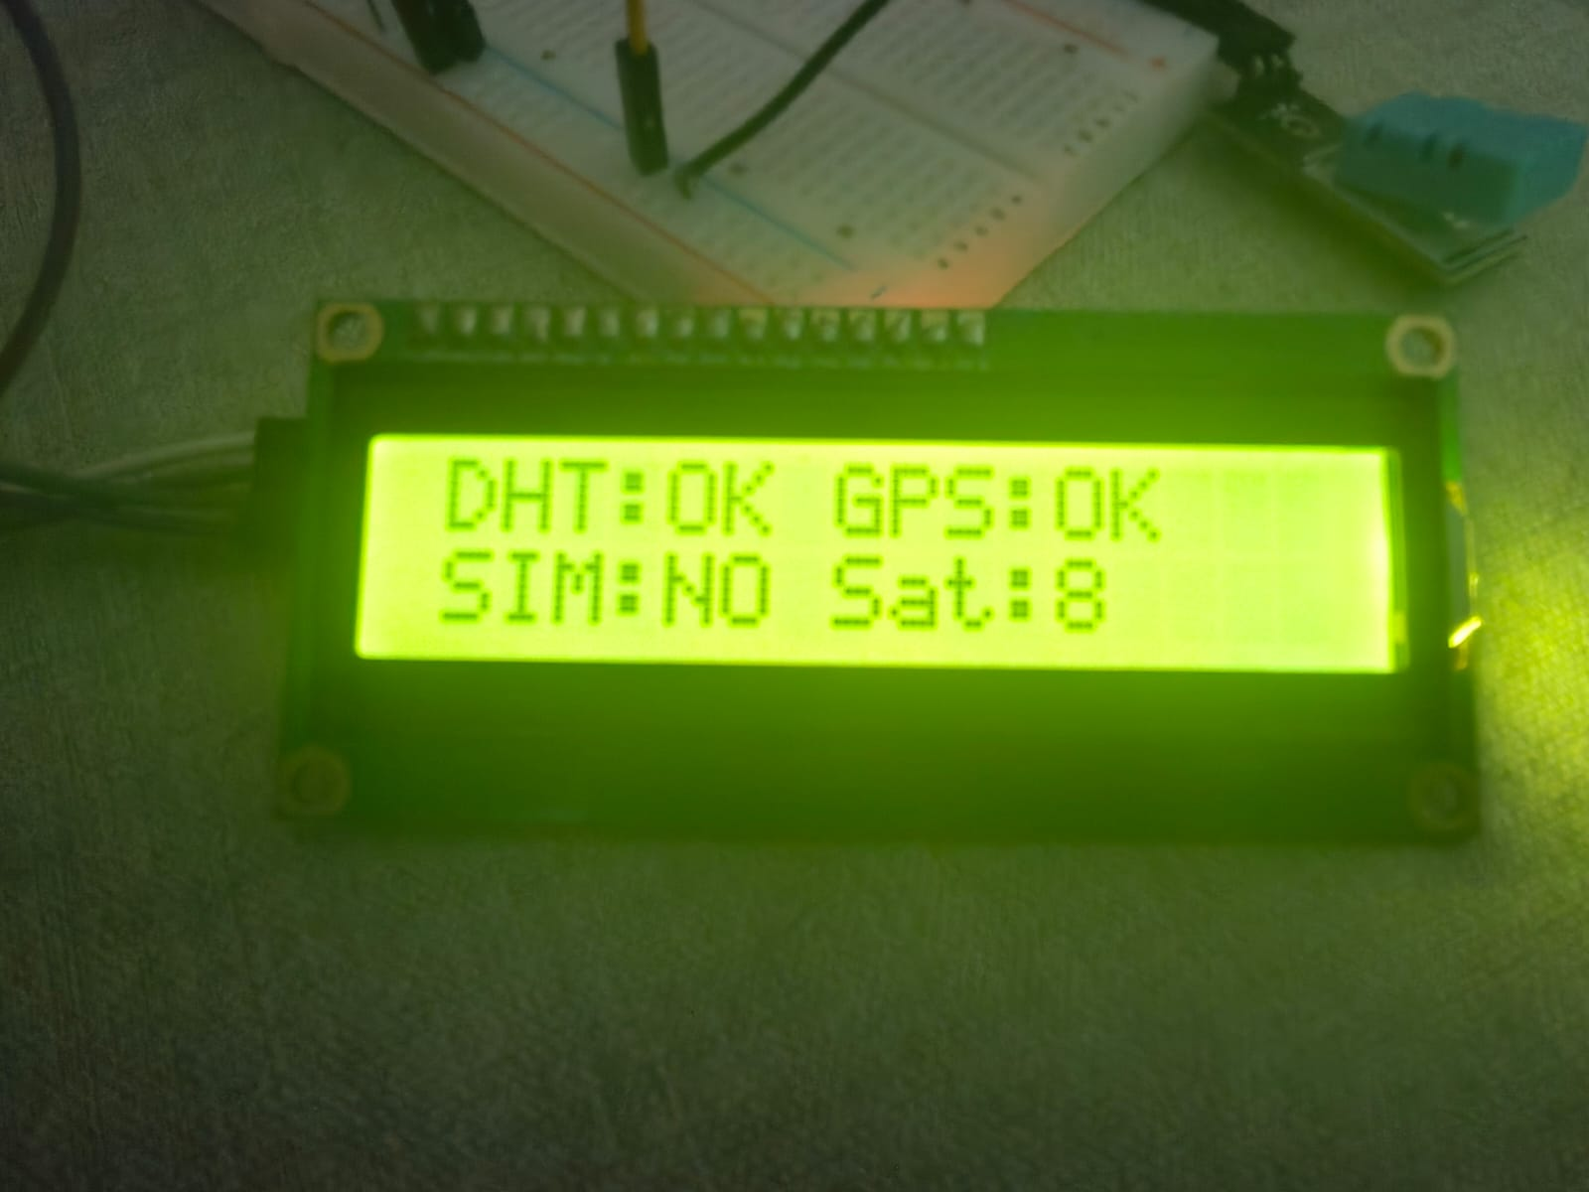
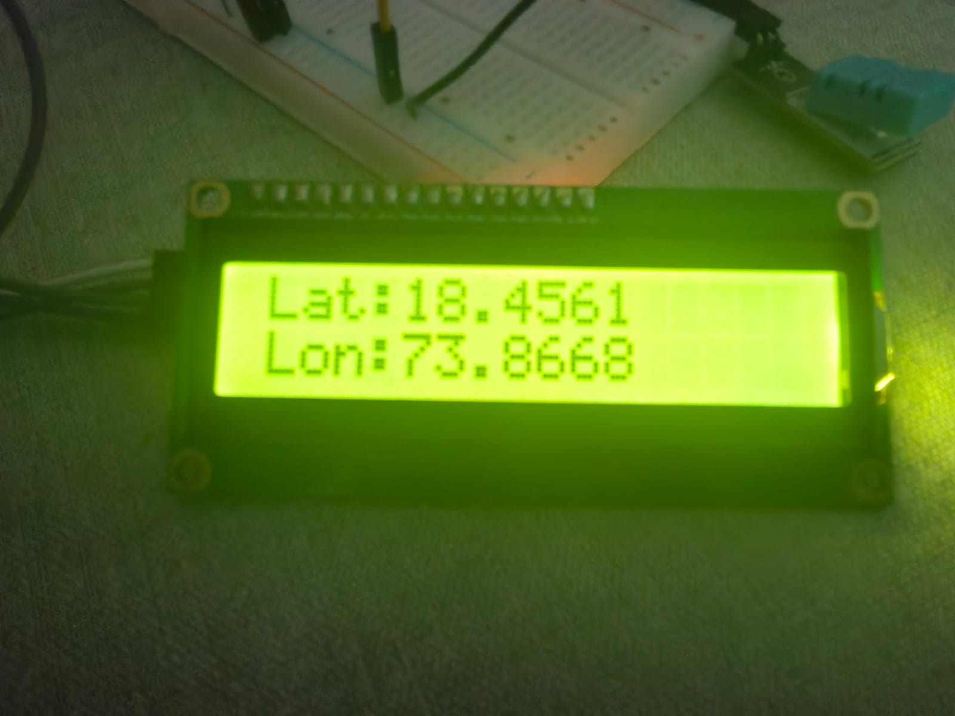
Roll Nos: 50,51,52,53, Department of Engineering, Sciences and Humanities, VIT, Pune

Slide 22
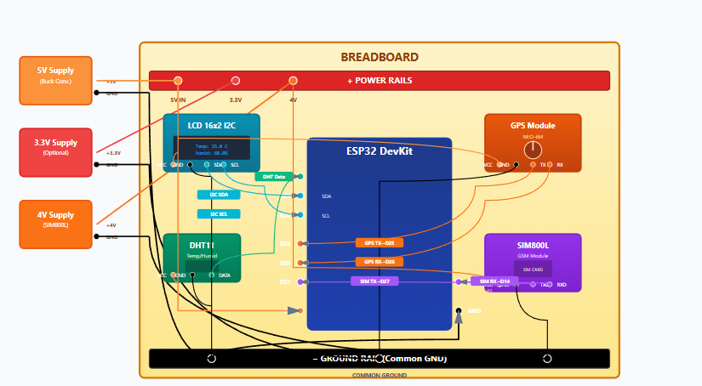
CIRCUIT DIAGRAM
Roll Nos: 50,51,52,53, Department of Engineering, Sciences and Humanities, VIT, Pune

Slide 23
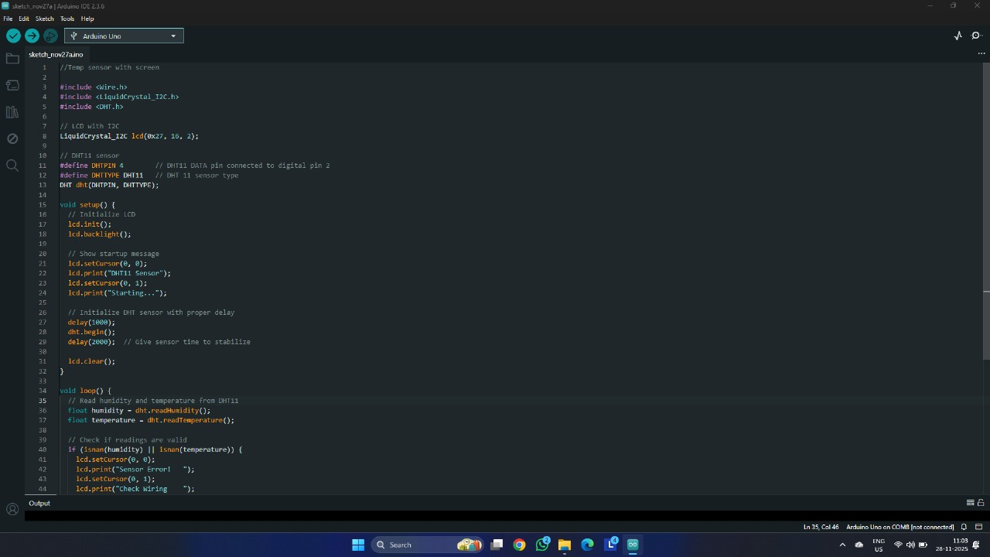
Roll Nos: 50,51,52,53, Department of Engineering, Sciences and Humanities, VIT, Pune

Slide 24
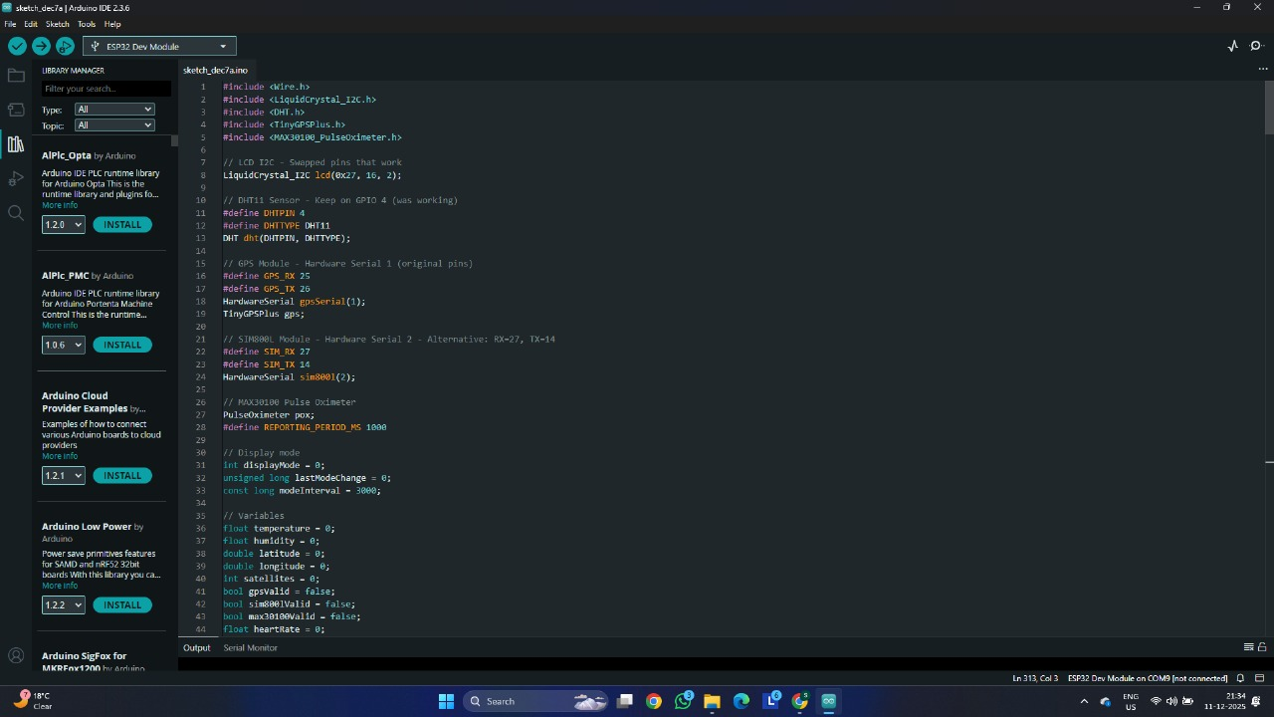
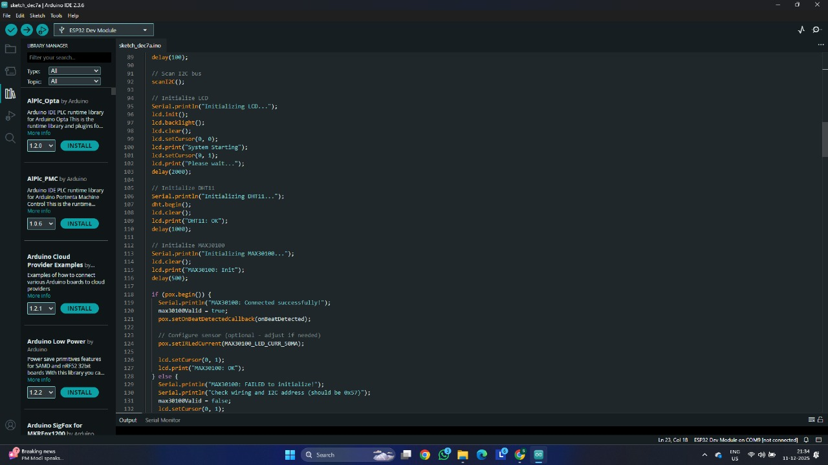
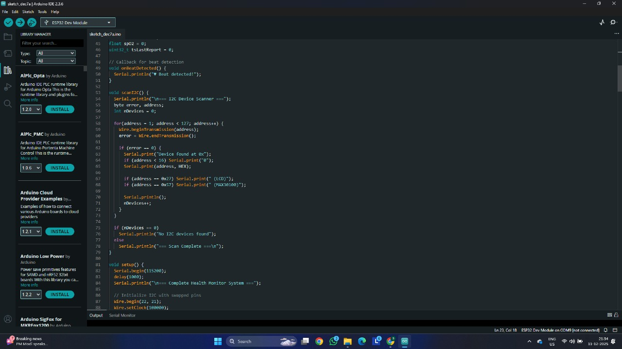
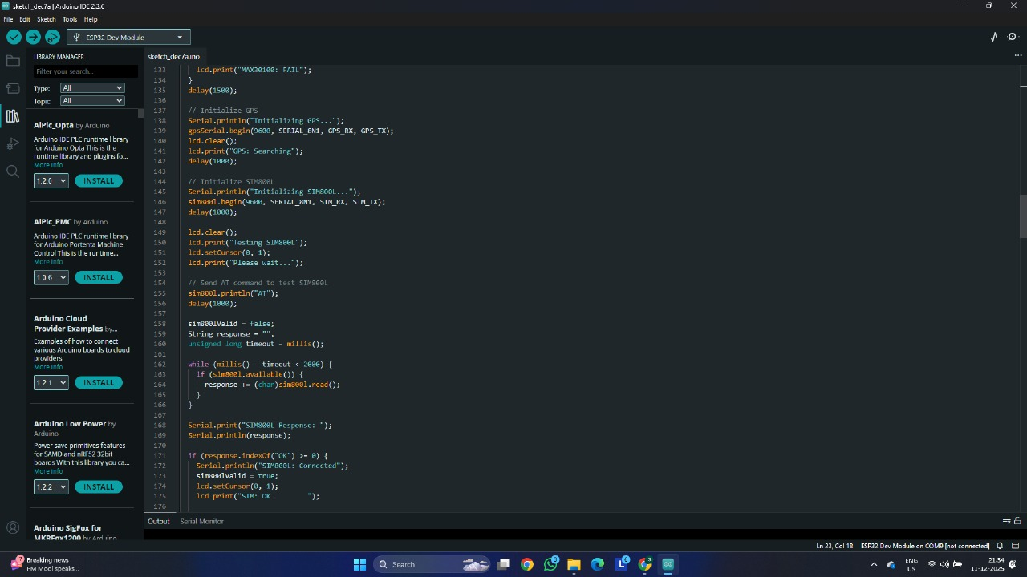
Roll Nos: 50,51,52,53, Department of Engineering, Sciences and Humanities, VIT, Pune

Slide 25
Thank You!
Roll Nos: 50,51,52,53, Department of Engineering, Sciences and Humanities, VIT, Pune

